Slide 1





DROITE Lyon 10/2012
Nonlinear phase retrieval in line-phase tomography
Valentina Davidoiu¹
Bruno Sixou¹, Françoise Peyrin^{1,2} and Max Langer^{1,2}
¹CREATIS, CNRS UMR 5220, INSERM U630, INSA, Lyon, France
²European Synchrotron Radiation Facility, Grenoble, France
valentina.davidoiu@creatis.insa-lyon.fr
Workshop DROITE
October, 24th 2012

Slide 2
DROITE Lyon 10/2012
Outline
Background
  Phase problem
  Phase versus Absorption
  Images formation and acquisition
Linear algorithms
  TIE, CTF and Mixed
Nonlinear combined algorithm
  Formulation, regularization, simulated data
Conclusions and future works
2

Slide 3
DROITE Lyon 10/2012
Why Phase retrieval?
  There are two relevant parameters for diffracted waves: amplitude and phase
  Problem: A simple Fourier transform retrieves only the intensity information and so is insufficient for creating an image from the diffraction pattern due to the loss of the phase
  Solution: “phase recovery” algorithms
  How: The phase shift induced by the object can be retrieved through the solution of an ill-posed inverse problem
  Why?
    Zero Dose → increase the energy → absorption contrast is low
    Better sensitivity →absorption contrast is too low
Phase retrieval imaging
3

Slide 4
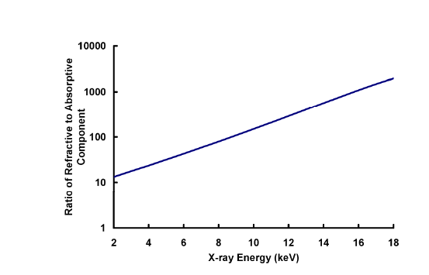
DROIT Lyon 10/2012
Phase versus Absorption
Phase sensitive X-ray imaging extends standard X-ray microscopy techniques by offering up to a thousand times higher sensitivity than absorption-based techniques
  Offering a higher sensitivity than absorption-based techniques (1→1000)
The ratio of the refractive to the absorptive parts of the refractive index of carbon as a function of X-ray energy. The plot was calculated using the website: http://henke.lbl.gov/optical_constants/
4
Notes:
The object can be described by its 3D complex refractive index(n),

Slide 5
DROITE Lyon 10/2012
Phase Problem
Specifically requirements:
  High spatial coherence, monochromaticity and high flux
    Synchrotron sources
    Alternative sources: Coherent X-ray microscopes(Mayo 2003) and grating interferometers (Pfeiffer 2006)
X-ray Phase Imaging Techniques
  Analyzer based (Ingal 1995, Davis 1995, Chapman1997)
  Interferometry (Bones and Hart 1965, Momose 1996)
  Propagation based techniques (Snigirev 1995)
5

Slide 6
DROITE Lyon 10/2012
Propagation based techniques
Images acquisition (ID19 « in-line phase tomography setup »)
  Phase contrast is achieved by moving the detector downstream of the imaged object
  Image formation is described by a quantitative, but nonlinear relationship (Fresnel diffraction).
CCD
≈ 140 m
≈ 2 m
sample
Insertion
Device
Multilayer
Monochromator
0.03 to 0.990 m
Near field Fresnel diffraction
Light optics
system
Rotation stage
6

Slide 7
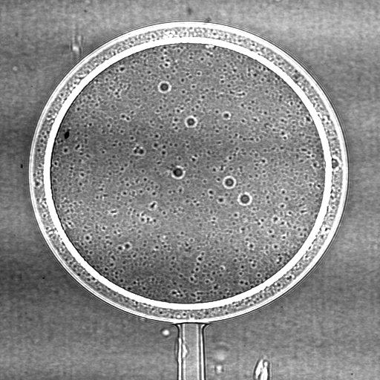
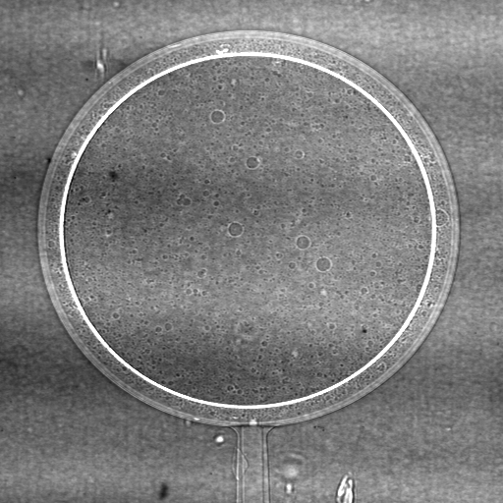
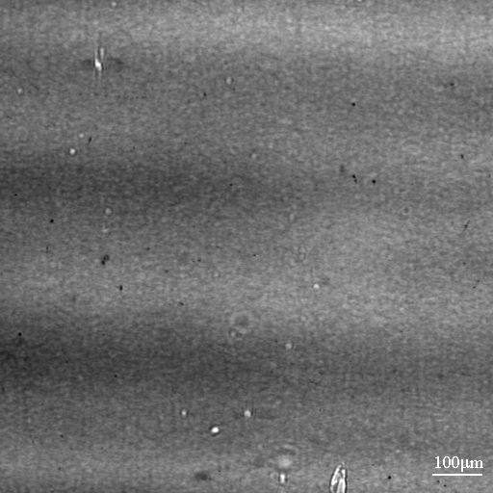
DROITE Lyon 10/2012
Propagation based techniques
“In-line X-ray phase contrast imaging”
D=830mm
inner layer
D=190mm
polystyrene
thickness 30 µm
D=3mm
outer layer
850 µm
parylene
thickness 15 µm
Coherent X-rays
E=20.5 keV
Snigirev et al. (1999)
7

Slide 8
DROITE Lyon 10/2012
Propagation and Fresnel diffraction
Plan monochromatic
D
Rotation stage
Detector
Monochromator
u_{inc}
D₁
u₀
D₂
D₃
Absorption
Absorption
and phase
« white synchrotron beam »
Fresnel diffraction
Fresnel diffracted intensity
  The propagator:
  Transmittance function:
8

Slide 9
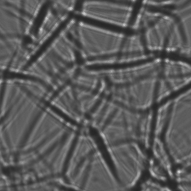

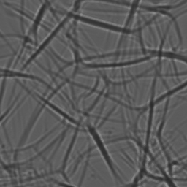
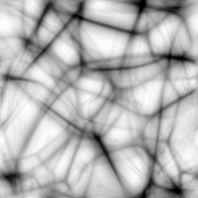
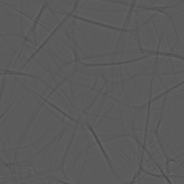
DROITE Lyon 10/2012
Inverse problem - phase tomography
  1st step: Phase map
D
Phase map
  2nd step: Tomography
    3D reconstruction (FBP to the set of phase maps)
    Improved sensitivity
    Straightforward interpretation and processing
PS foam
Cloetens et al. (1999)
9

Slide 10
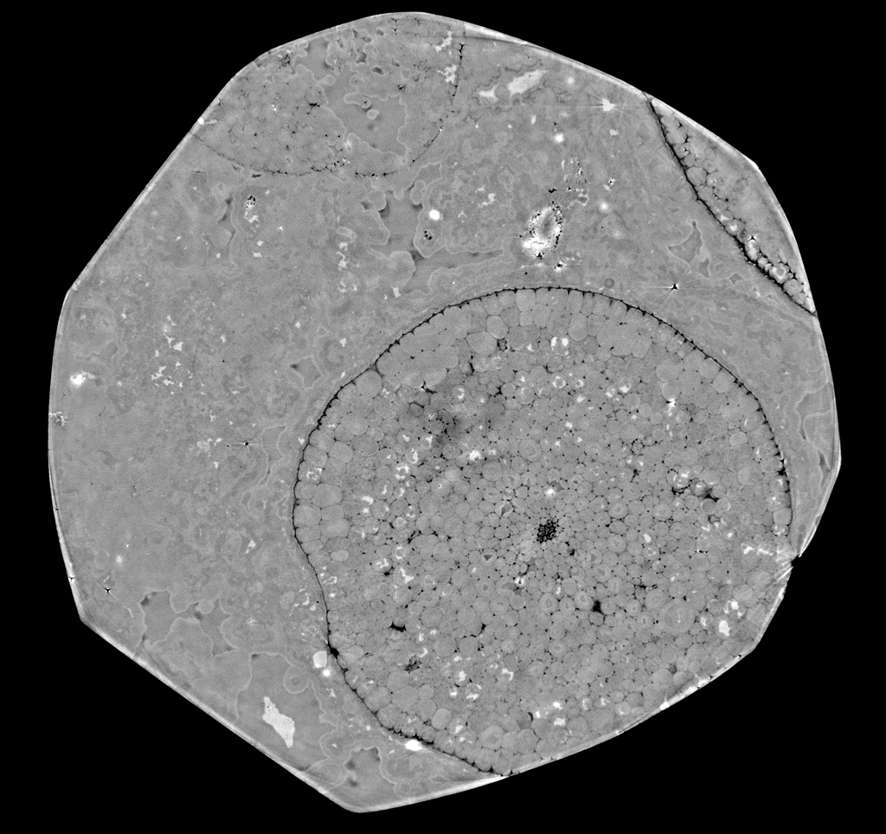
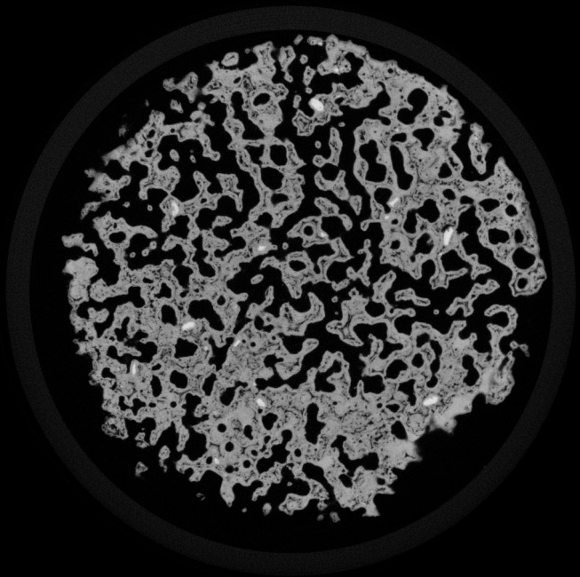
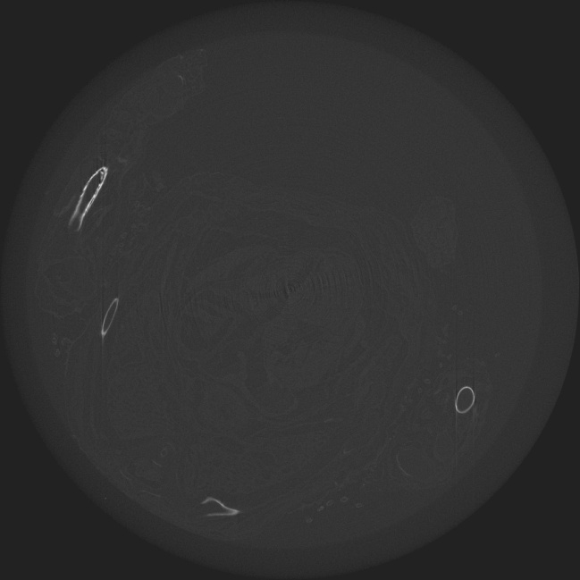
DROITE Lyon 10/2012
Applications
Phase contrast has very different applications
Paleontology
Bone research
Small animal imaging
Langer et al.
10

Slide 11
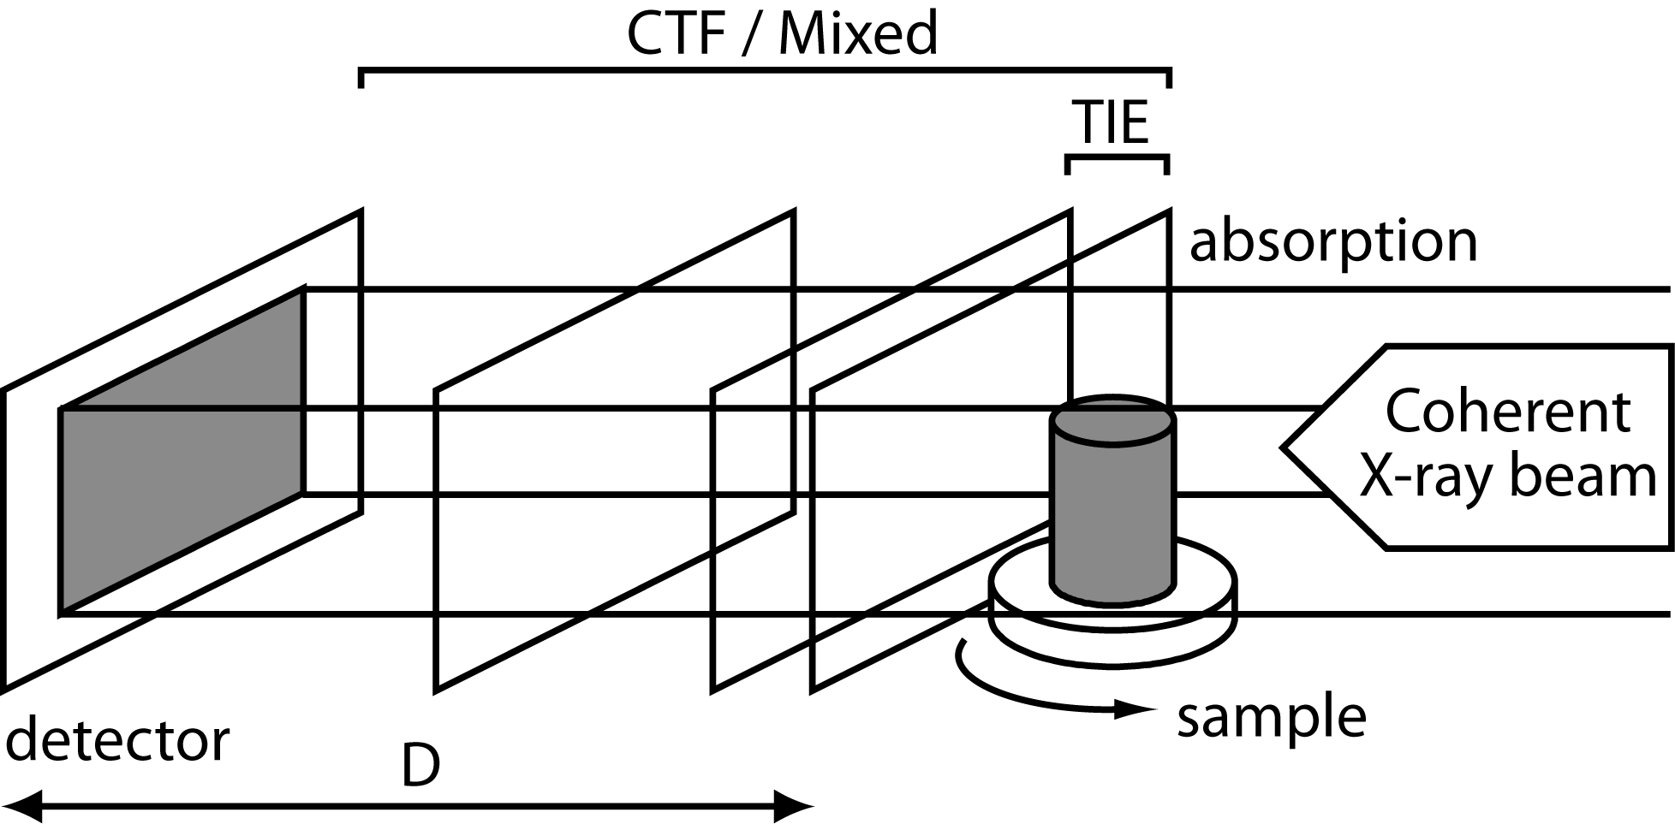
DROITE Lyon 10/2012
The Linear Invers Problem
Based on linearization of
  PDE between the phase and intensity
«Transport Intensity Equation » (TIE)→ in the propagation direction
    Valid for mixed objects but short propagation distances (only 2)
      Gureyev, Wilkins, Paganin et al., Australia
      Bronnikov, Netherlands
«Contrast Transfer Function » (CTF) → with respect to the object
    Valid for weak absorption and slowly varying phase
    Disagrees TIE for short distances
      Guigay, Cloetens, France
«Mixed Approach» → unifies TIE and CTF
    Valid for absorptions and phases strong, but slowly varying
    Approach TIE if D → 0
      Guigay, Langer, Cloetens , France
11

Slide 12
DROITE Lyon 10/2012
The Linear Invers Problem
A inverse linear problem:
    Approaches Linear [3]
      Valid for weak absorption and slowly varying phase
      Linearization of the forward problem in the Fourier domain
  Approaches Nonlinear [4]
    Landweber type iterative method with Tikhonov regularization
  These approaches are based on a the knowledge of the absorption
  Generalization: simultaneous retrieval of phase and absorption
[3] Langer et al.,(2008)
[4] Davidoiu et al,( 2011)
12
Notes:
with epsilon additive Gaussian noise.

Slide 13
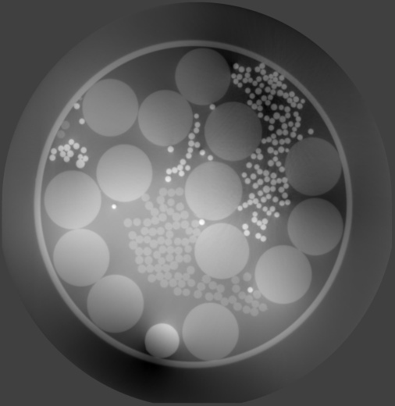
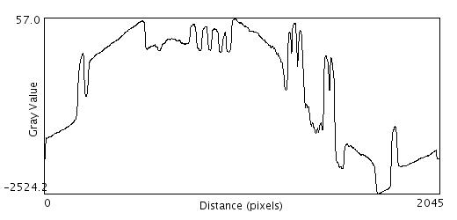
DROITE Lyon 10/2012
Mixed Approach
Hypothesis: absorption and phase are slowly varying
  The linearized forward problem in the Fourier domain [3]:
Limitations :
  restrictive hypothesis
  typical low frequency noise
  loss of resolution due
  to linearization
Phantom : 0.7 μm
PET
Al₂O₃
200 μm
Al
PP
[3] Langer et al,(2008)
13

Slide 14
Nonlinear Inverse Problem – Fréchet Derivative
DROITE Lyon 10/2012
The Fréchet derivative of the operator at the point
is the linear operator
Landweber type iterative method
  Minimize the Tikhonov's functional :
  The optimality condition defining the descent direction
  of the steepest descent is:
  where is the adjoint of the Fréchet derivative of the intensity
[4] Davidoiu et al,( 2011).
14

Slide 15
Projection Operator
DROITE Lyon 10/2012
Analytical expression of the Fréchet derivative
if
  a given transmission at iteration “k” on set
  the projectors and are applied successively
avec
15

Slide 16
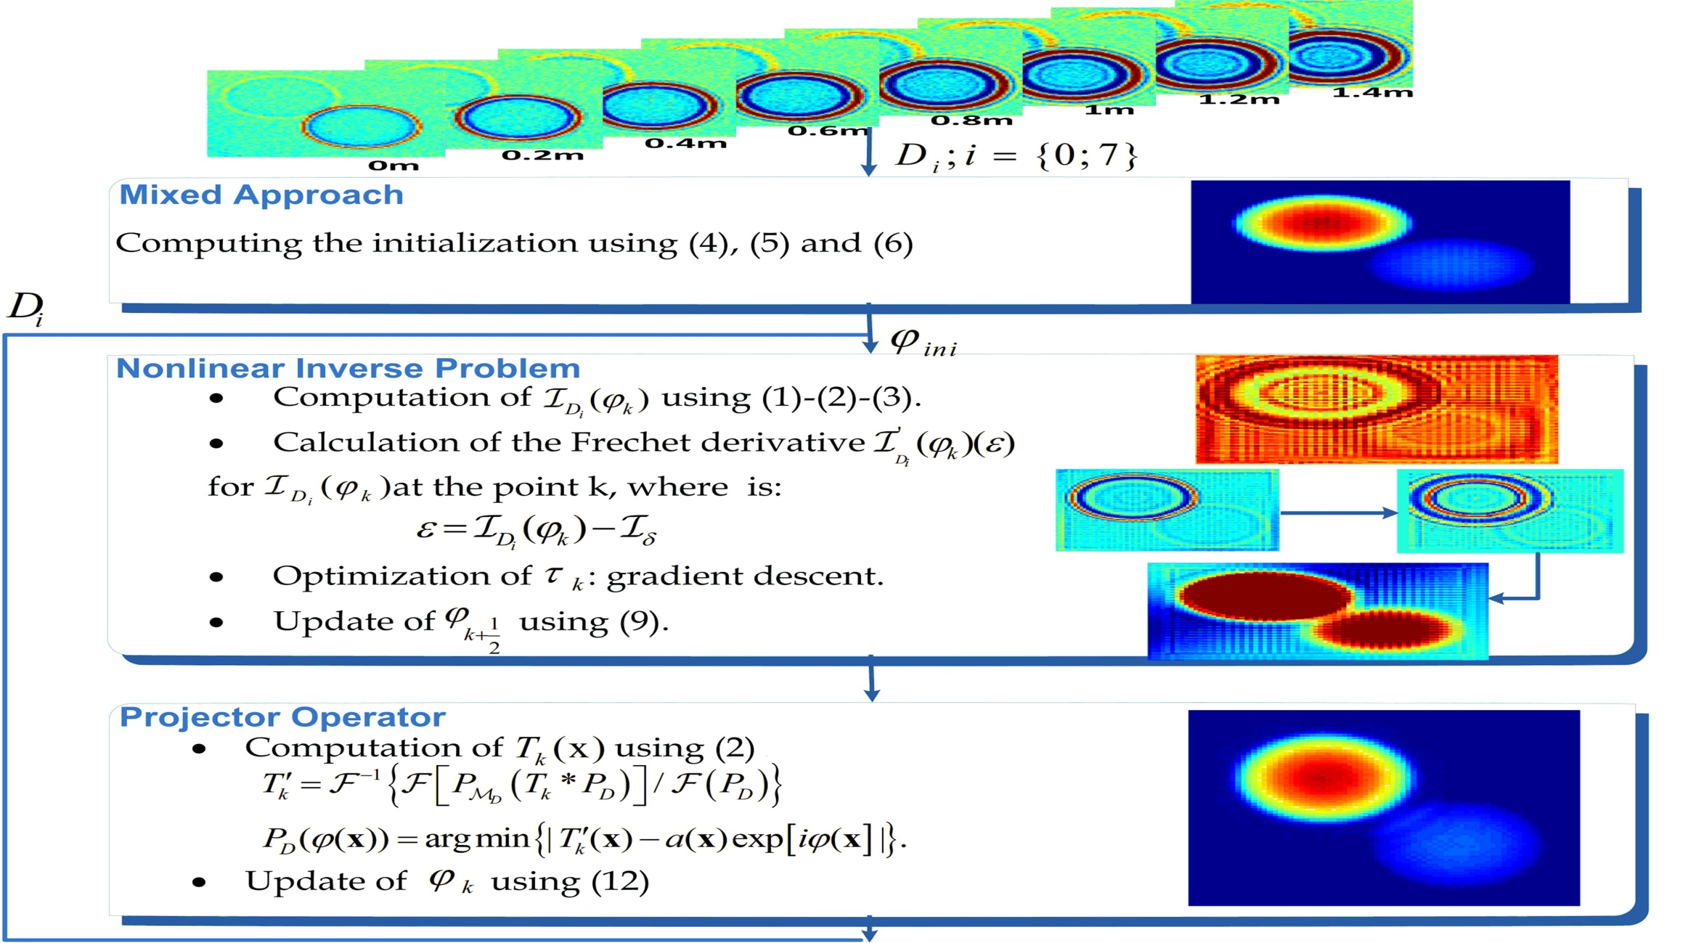
DROITE Lyon 10/2012
Approach nonlinear and projection operator
16

Slide 17
DROITE Lyon 10/2012
Phase retreival using iterative wavelet thresholding
Landweber type iterative method
  Hypothesis: The phase admits a sparse representation in a orthogonal wavelet bas
  where x is a wavelet coefficients vector, and W* is the synthesis operator,
  I an infinite set which includes the level of the resolution, the position and the type of wavelet
Resolution with an iterative method
  Minimize the Tikhonov's functional :
    regularization parameter
  The first term is convex, semi-continuous and differentiable ( -Lipschitz)
17

Slide 18
DROITE Lyon 10/2012
Phase retrieval using iterative wavelet thresholding
Iterative method [6,7]:
  and
  with the soft thresholding operator.
  the solution is obtained from the final iterate
  (R) is implemented only at the lowest level of resolution and the operator WAW* is approximated with the lowest level of resolution
[6] I.Daubechies et,(2008).
[7] C.Chaux et al., (2007).
18

Slide 19
DROITE Lyon 10/2012
Iterative phase retrieval
Calculation of nonlinear inverse problem using the analytical expression for the Fréchet derivative
Update of the phase retrieved using the projector operator
Phase updated decomposition in the wavelet domain using a linear operator
19

Slide 20
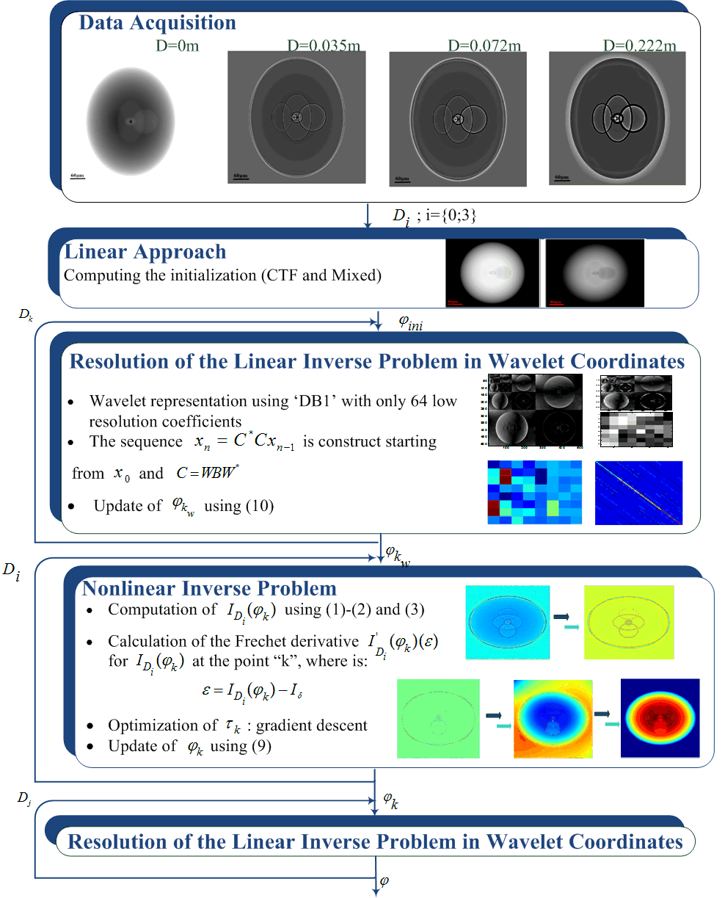
DROITE Lyon 10/2012
Iterative phase retrieval
20

Slide 21
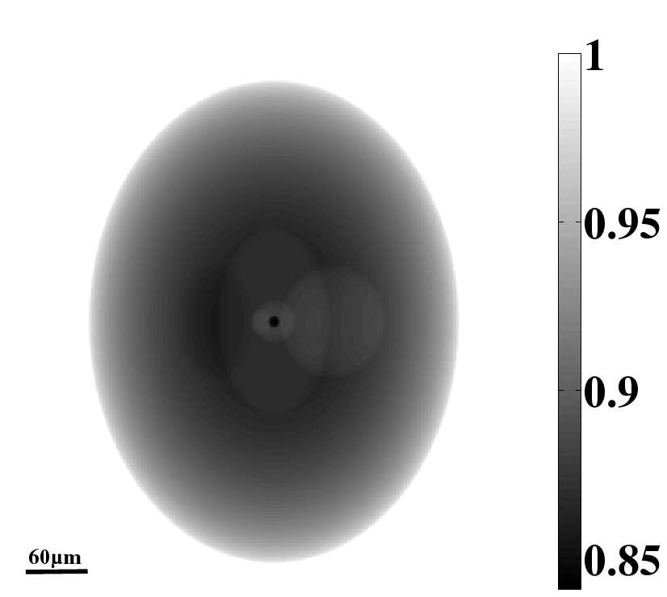
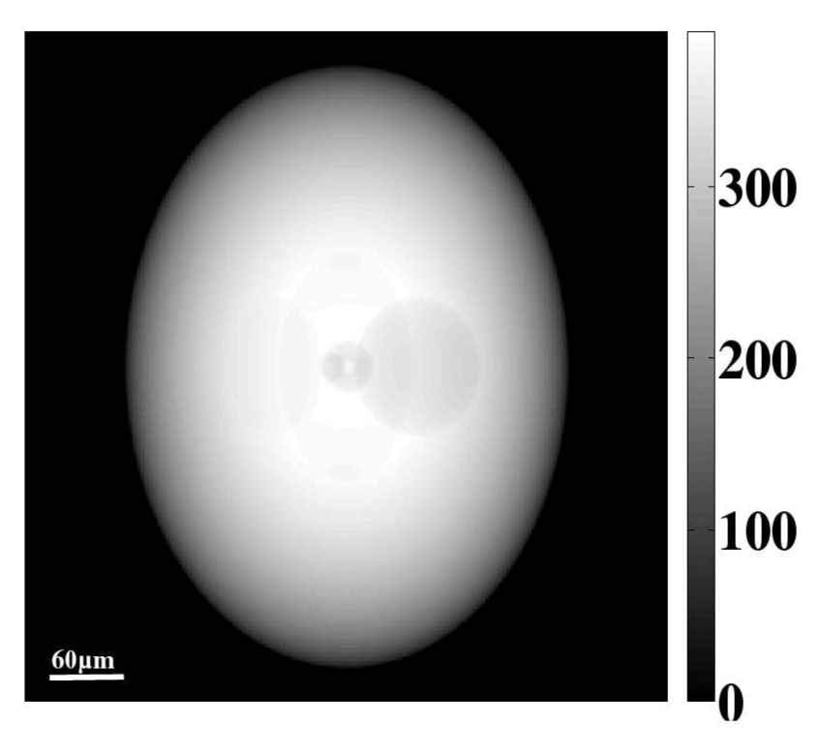
Simulations
DROITE Lyon 10/2012
Absorption index
Refractive index
  3D Shepp-Logan phantom, 2048×2048×2048, pixel size= 1µm
  Analytical projections, 4 images/distances
  Propagation simulated by convolution, calculated in Fourier space
  Projections resampled to 512×512
21

Slide 22
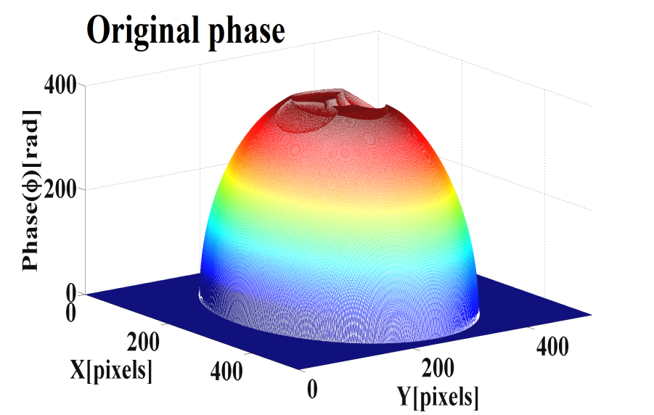
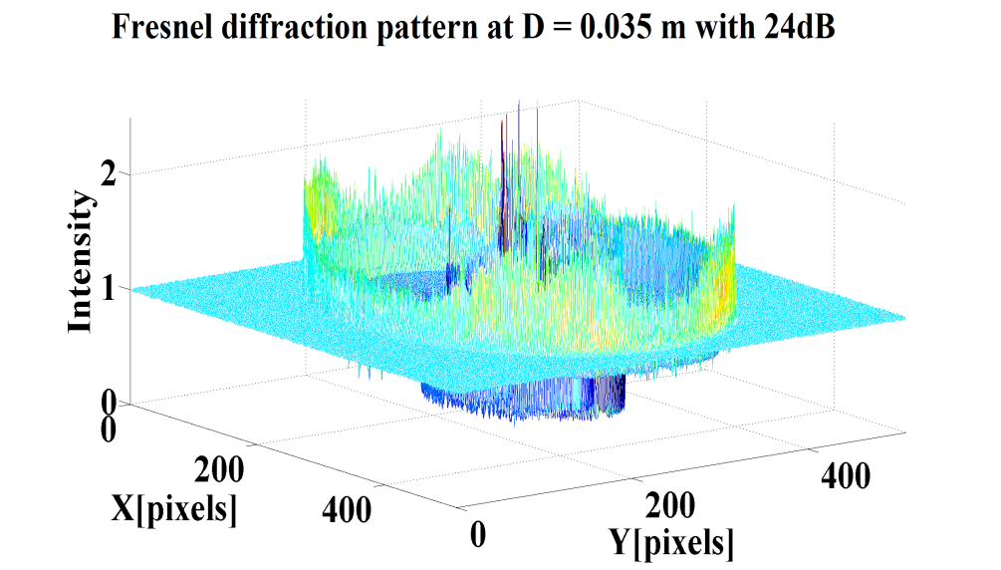
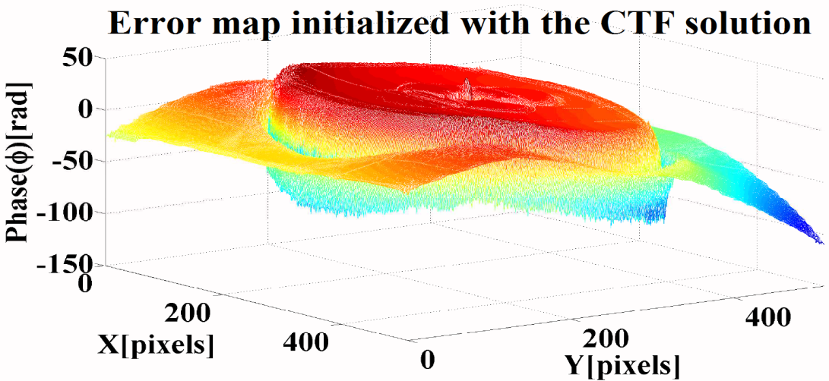
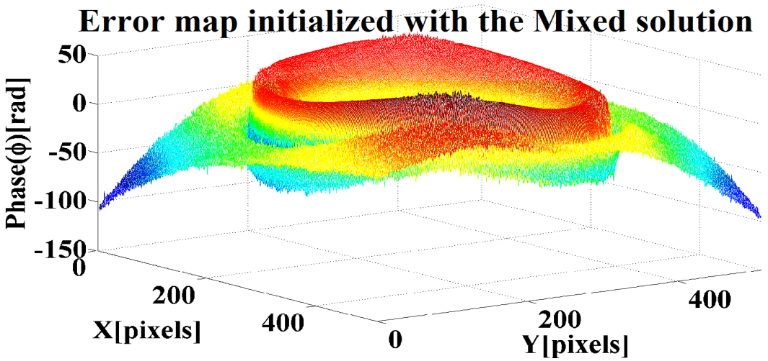
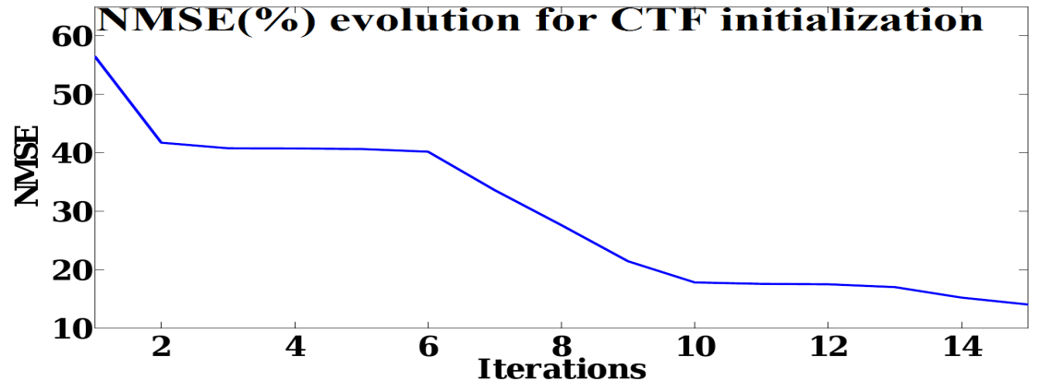
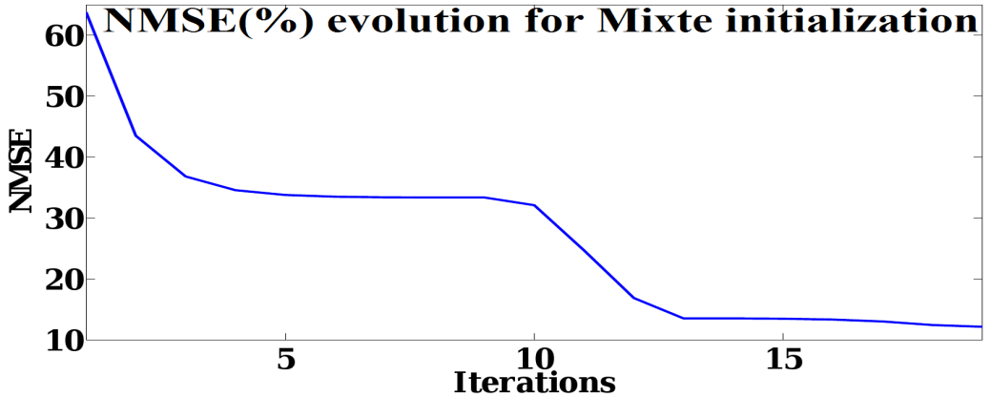
DROITE Lyon 10/2012
Simulations
21

Slide 23
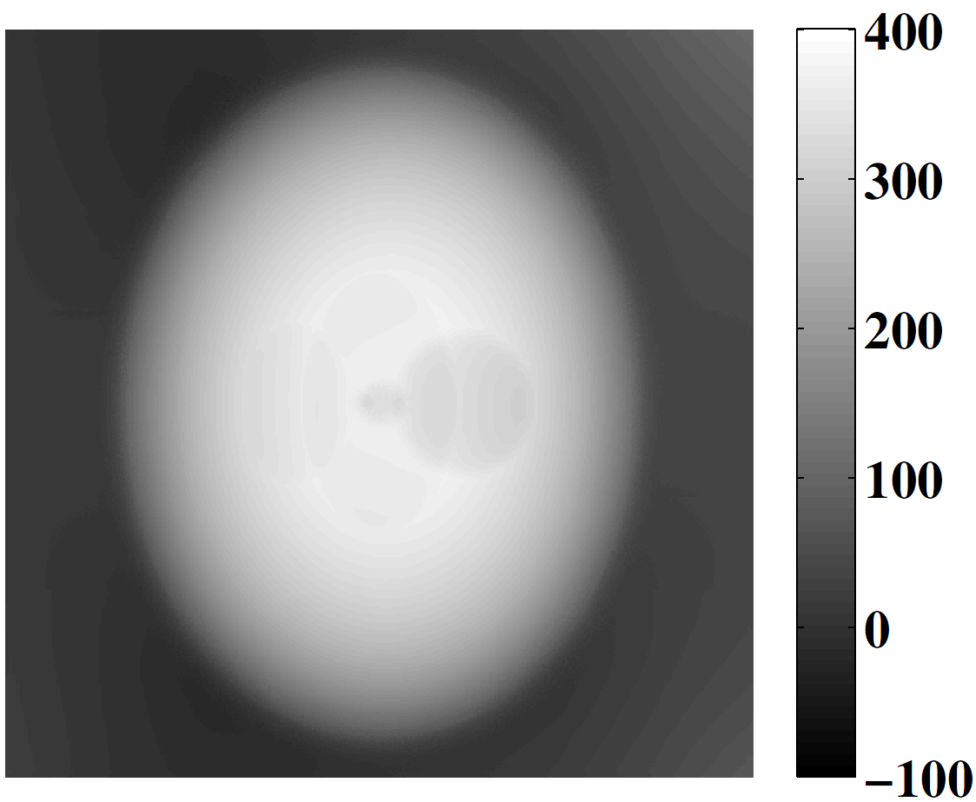
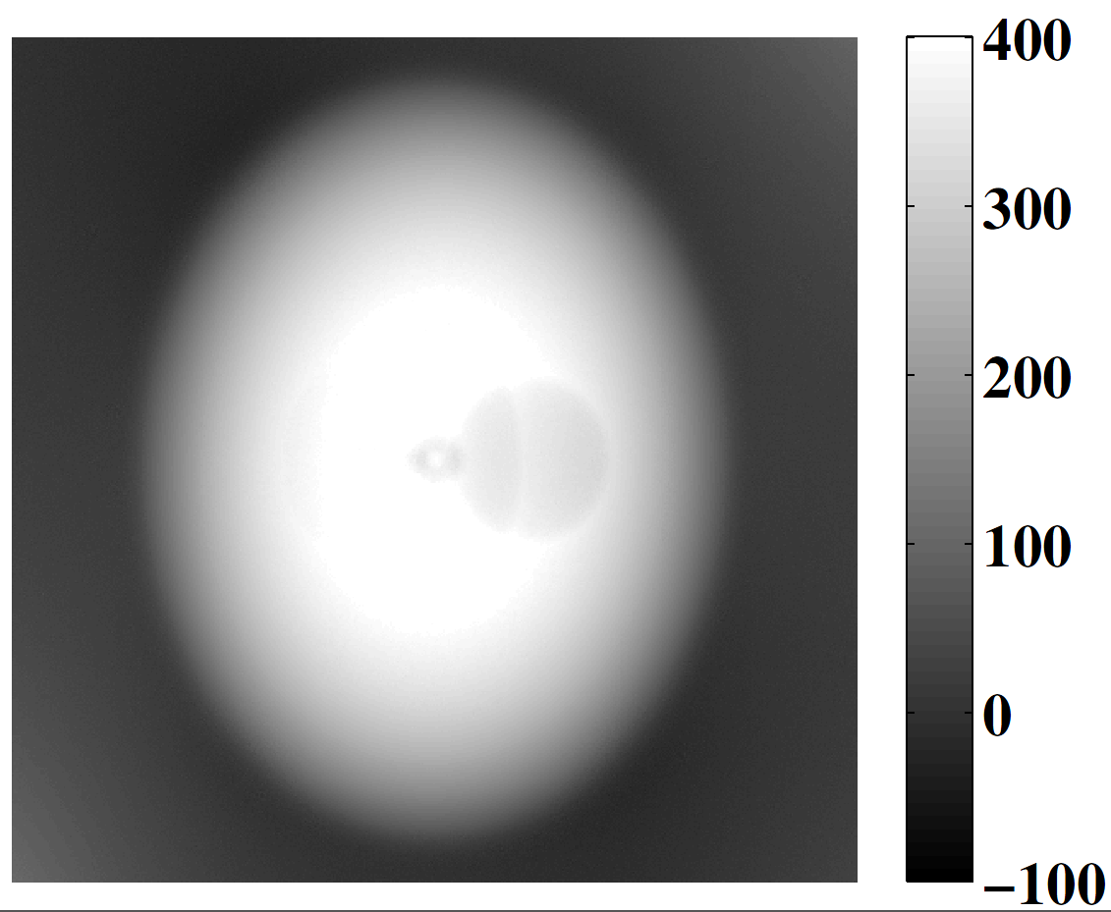
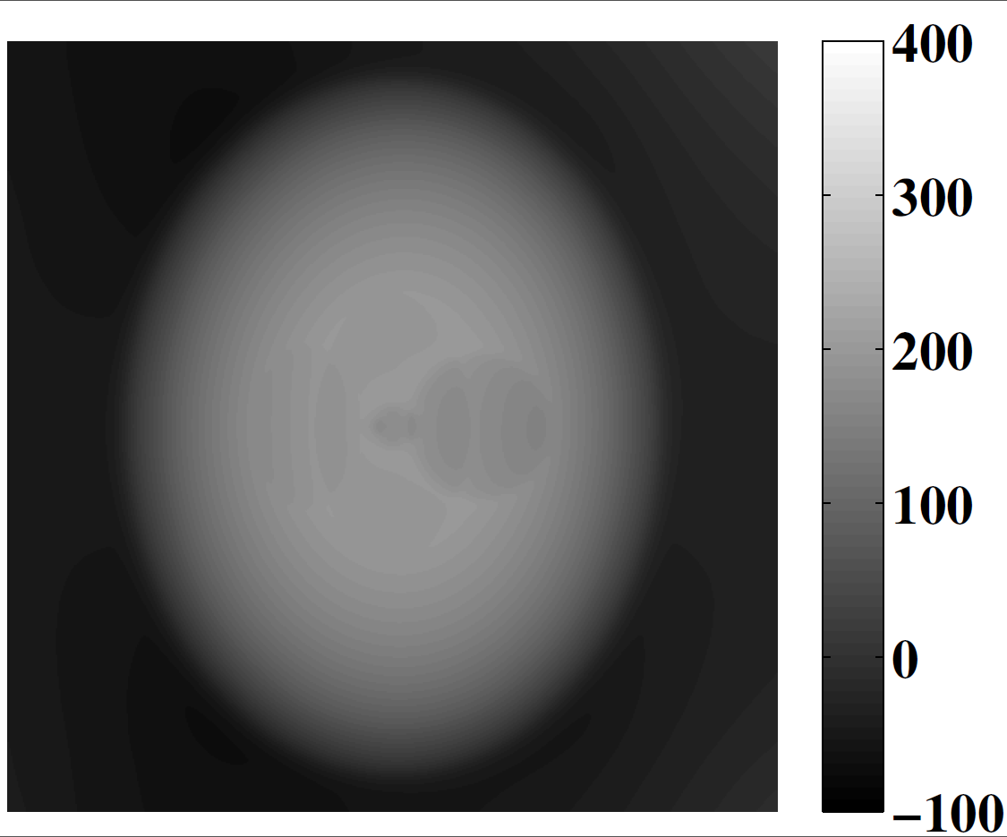
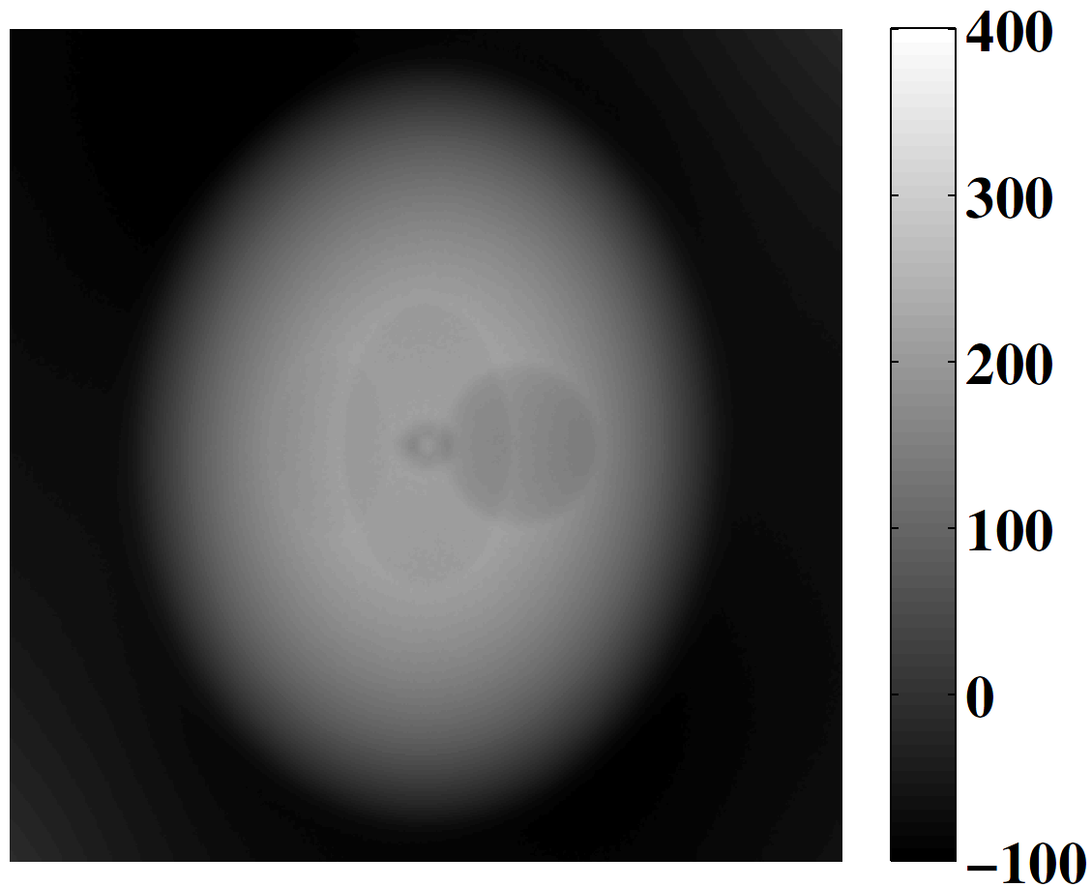
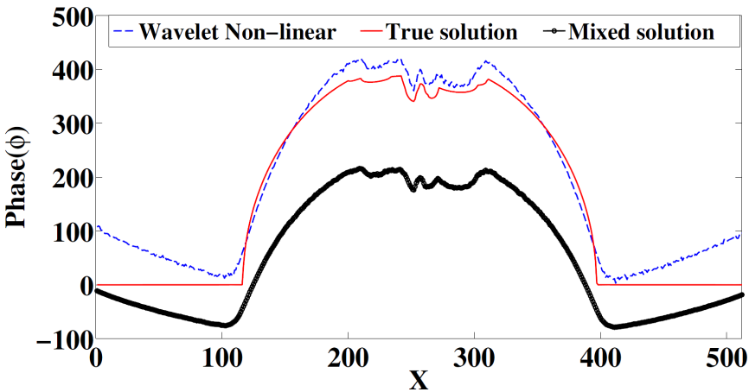
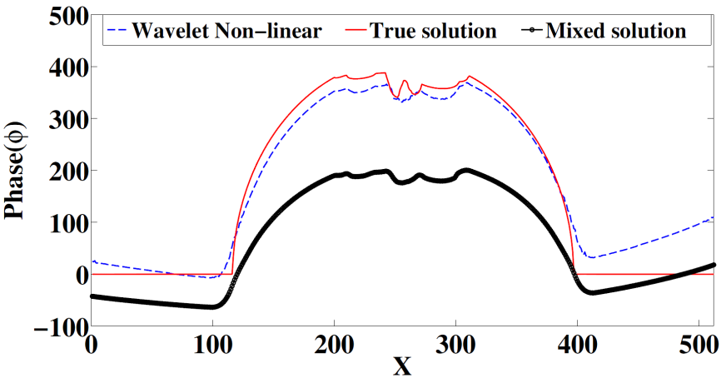
CFR 2012 Bucarest
DROITE Lyon 10/2012
Simulations
WNL phase with Mixed starting
point
WNL phase with CTF starting
point
Mixed phase
CTF phase
[8] Davidoiu et al., (2012)
23

Slide 24
DROITE Lyon 10/2012
Simulations
NMSE(%) values ​​for different algorithms
PPSNR[dB] | Initialization NMSE(%)] | NL [NMSE(%)] | WNL [NMSE(%)]
without noise | TIE 25.54% | 9.69% | 8.92%
 | CTF 42.52% | 24.66% | 6.57%
 | Mixed 26.81% | 11.42% | 7.50%
48dB | TIE 35.57% | 18.65% | 11.12%
 | CTF 33.75% | 11.87% | 8.94%
 | Mixed 26.01% | 13.71% | 8.76%
24dB | TIE 262.13% | 207.44% | 98.04%
 | CTF 56.54% | 26.80% | 14.05%
 | Mixed 63.84% | 41.99% | 12.16%
12dB | TIE 791.68% | 791.68% | 81.77%
 | CTF 123.42% | 101.42% | 36.40%
 | Mixed 57.30% | 57.30% | 28.53%
[9] Davidoiu et al, submitted to IEEE IP( 2012)
24

Slide 25
DROITE Lyon 10/2012
  New approach that combines two iterative methods for phase retrieval using projection operator and iterative wavelet thresholding
  Improved the results obtained with Tikhonov regularization for very noisy signals
Conclusions
Nonlinear Algorithm
Wavelet Algorithm
Initialization
Analytical derivative
Projector Operator
Soft thresholding operator
Lowest level of resolution
Final Phase solution
25

Slide 26
DROITE Lyon 10/2012
Perspectives
This method is expected to open new perspectives for the examination of biological samples and will be tested at ESRF (European Synchrotron Radiation Facility, Grenoble, France) on experimental data
Apply the method to tomography reconstruction (biological data and more complex phantom)
Test other approaches for directional representations of image data : shearlets
Set up automatically the regularization parameter
26

Slide 27
DROITE Lyon 10/2012
Publications
V. Davidoiu, B. Sixou, M. Langer, and F. Peyrin, “Non-linear iterative phase retrieval based on Frechet derivative", Optics EXPRESS, vol. 19, No. 23, pp. 22809–22819, 2011.
V. Davidoiu, B. Sixou, M. Langer, and F. Peyrin , "Nonlinear phase retrieval and projection operator combined with iterative wavelet thresholding", IEEE Signal Processing Letters , vol.19, No. 9, pp. 579 - 582 ,2012.
B. Sixou, V. Davidoiu, M. Langer, and F. Peyrin, "Absorption and phase retrieval in phase contrast imaging with nonlinear Tikhonov regularization and joint sparsity constraint regularization", Invers Problem and Imaging (IPI), accepted, 2012.
V. Davidoiu, B. Sixou, M. Langer, and F. Peyrin, "Comparison of nonlinear approaches for the phase retrieval problem involving regularizations with sparsity constraints", IEEE Image Processing, submitted
B. Sixou, V. Davidoiu, M. Langer, and F. Peyrin, “Non-linear phase retrieval from Fresnel diffraction patterns using Fréchet derivative", IEEE International Symposium on Biomedical Imaging - ISBI2011, Chicago, USA, pp. 1370–1373, 2011.
V. Davidoiu, B. Sixou, M. Langer, and F. Peyrin, ”Restitution de phase par seuillage itératif en ondelettes”, GRETSI, Bordeaux, 2011.
B. Sixou, V. Davidoiu, M. Langer, and F. Peyrin, “Absorption and phase retrieval in phase contrast imaging with non linear Tikhonov regularization", New Computational Methods for Inverse Problems 2012, Paris, France, 2012.
V. Davidoiu, B. Sixou, M. Langer, and F. Peyrin, ”Non-linear iterative phase retrieval based on Frechet derivative and projection operators", IEEE International Symposium on Biomedical Imaging - ISBI2012, Barcelona, Spain, pp. 106-109, 2012.
V. Davidoiu, B. Sixou, M. Langer, and F. Peyrin, “Non-linear phase retrieval combined with iterative thresholding in wavelet coordinates", 20th European Signal Processing Conference - EUSIPCO2012, Bucharest, Romania, pp. 884-888, 2012.
27

Slide 28
DROITE Lyon 10/2012
Merci beaucoup pour votre attention!
valentina.davidoiu@creatis.insa-lyon.fr

