Slide 1
Zooming tomography in X-Ray CT
Benjamin Yvernault

Slide 2
Summary
The problem
Context of the study
Solution 1 : supplement of the sinogram
Solution 2 : subtraction of sinograms
Results
In 3D

Slide 3
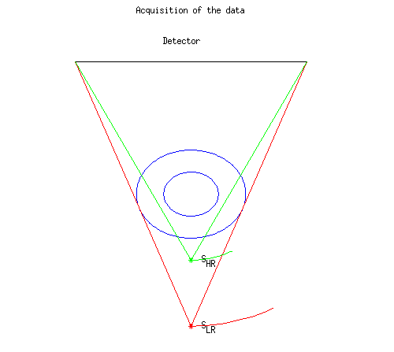
The Problem :
Acquisition of the data :
Blue : object
Red : low resolution (lines integrals/source position/trajectory)
Green : high resolution (lines integrals/source position/trajectory)
Black : detector

Slide 4
The Problem (2) :
Data LR -> not truncated but low resolution
Data HR -> better resolution but truncated
Question : How to reconstruct the object with a better resolution using the BR and HR truncated data?

Slide 5
Context of the Study
In 2D
Using MATLAB
Fan-beam geometry ( equi-spaced intervals )
Acquisition of the data «low resolution » (LR) and « high resolution » (HR)

Slide 6
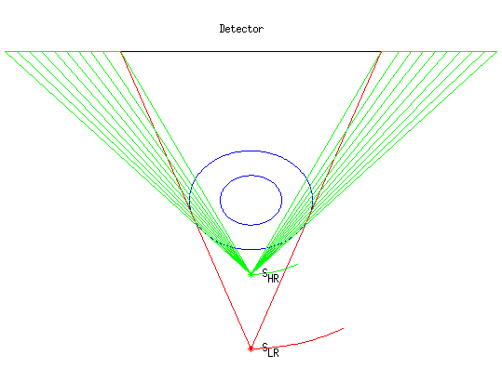
Solution 1 : supplement of the sinogram
The Goal :
Complete the sinogram HR by estimation of the line integrals with the reconstruction of the object in LR
Blue : object
Red line : low resolution (lines integrals/source position/trajectory)
Green : high resolution (lines integrals/source position/trajectory/supplement on the detector)
Black : detector

Slide 7
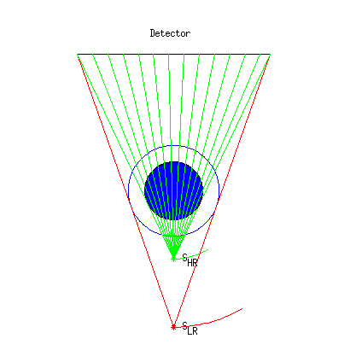
Solution 2 : subtraction of sinograms (1)
The Goal :
Estimate the sinogram HR from the object (where you take off the part of the object which can be reconstruct in HR) and subtract it to the HR sinogram
Blue : object
Red line : low resolution (lines integrals/source position/trajectory)
Green : high resolution (lines integrals/source position/trajectory)
Black : detector

Slide 8
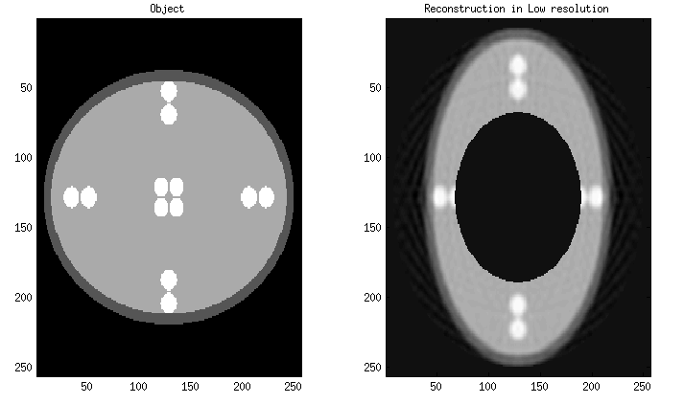
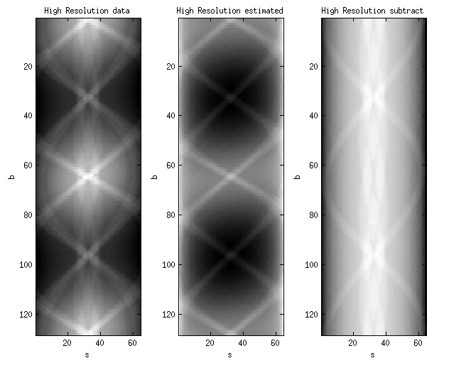
Solution 2 : subtraction of sinograms (2)

Slide 9
Results : Parameters
Parameters :
D = focal
R_LR = distance source - object LR / R_HR = distance source - object HR
r = radius of the object
nS = number of pixels on the detector
nβ = number of projections
x*y, nx*ny = parameters for the reconstruction of the object
D | R_LR | R_HR | r | ns | nβ | x*y | Nx*Ny
9 | 6 | 3 | 0.8 | 64 | 128 | 1.05r*1.05r | 256*256

Slide 10
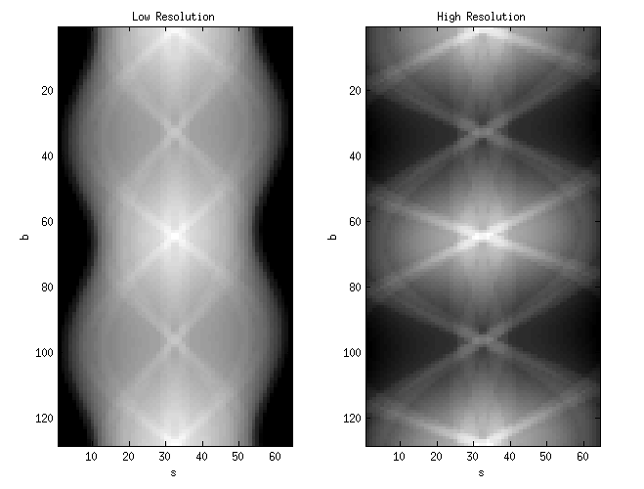
Method 1 : Data

Slide 11
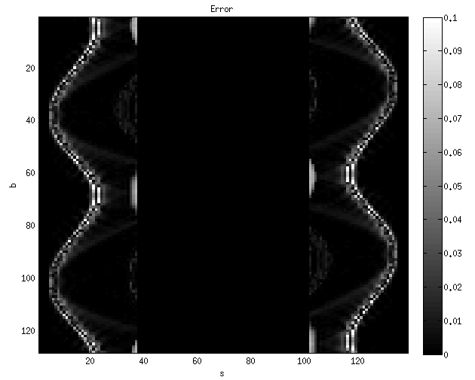
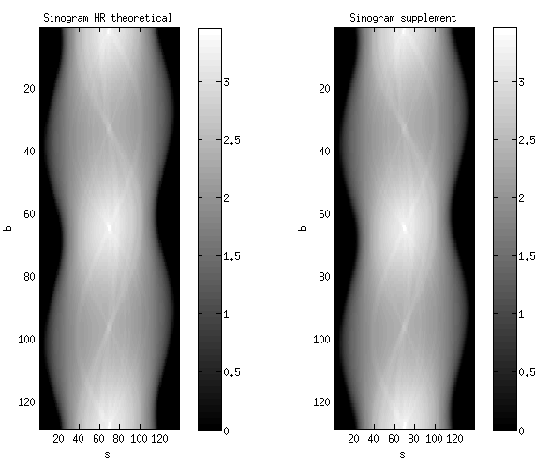
Method 1 : Sinograms HR
Error = | Sinogram theoretical – Sinogram supplement|

Slide 12
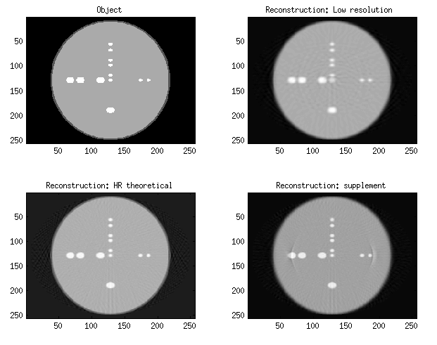
Method 1 : Reconstructions

Slide 13
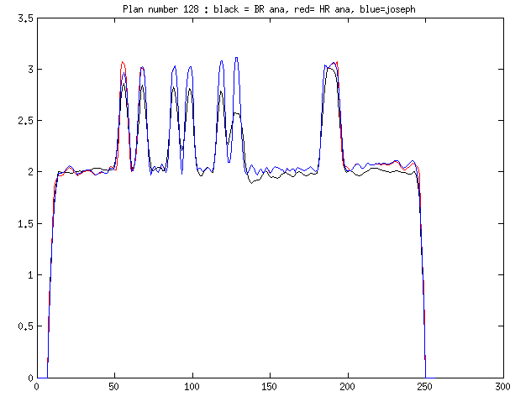
Method 1 : Plans

Slide 14
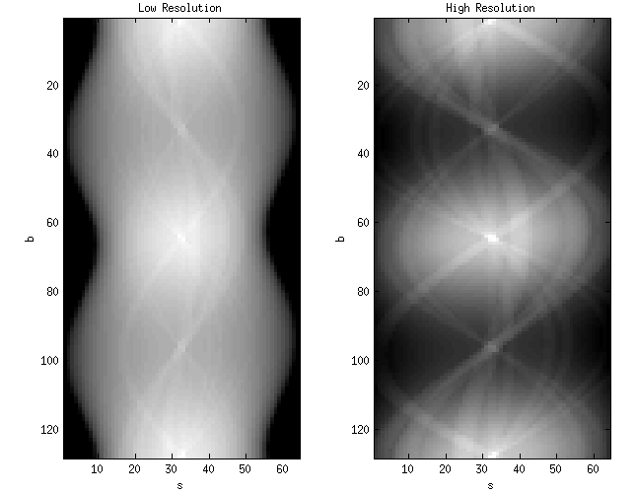
Method 2 : Data

Slide 15
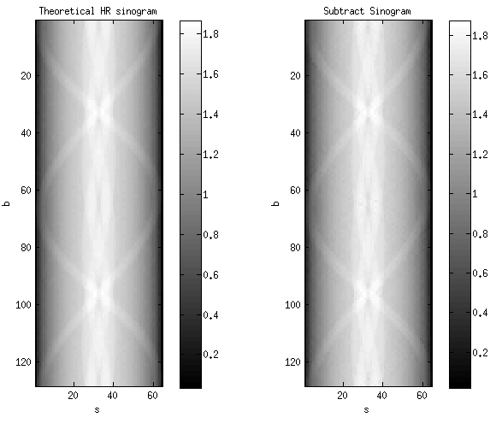
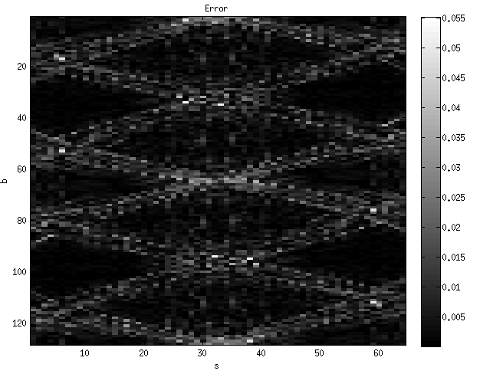
Method 2 : Sinograms HR
Error = | Sinogram theoretical – Sinogram supplement|

Slide 16
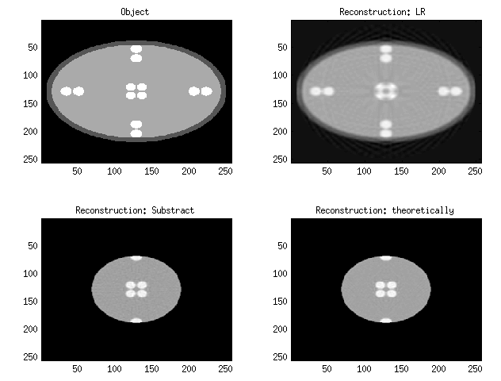
Method 2 : Reconstructions

Slide 17
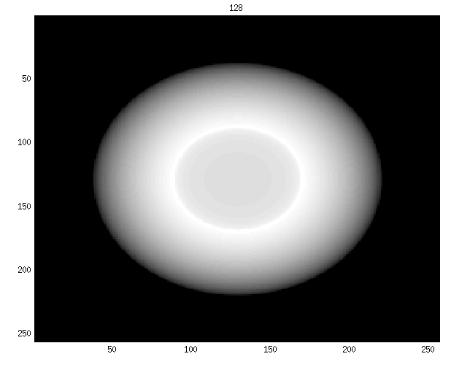
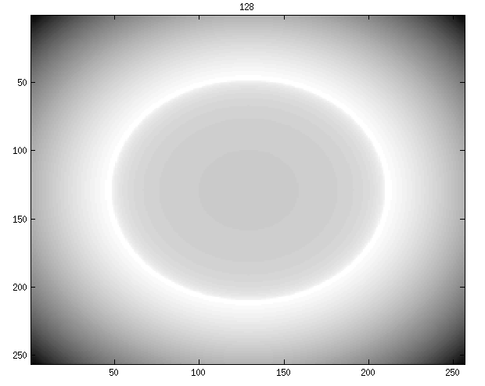
In 3D : Data
Low resolution High resolution

Slide 18
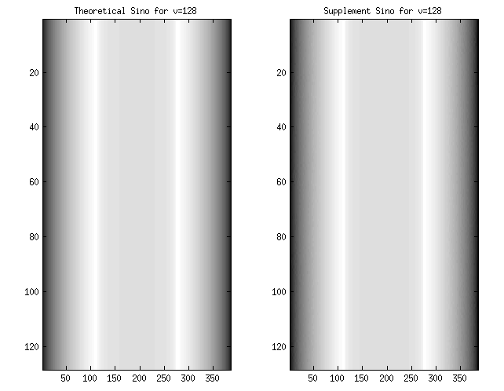
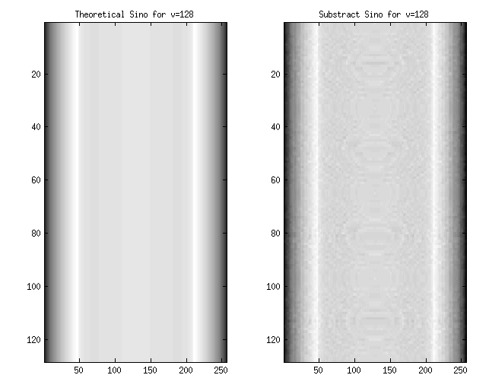
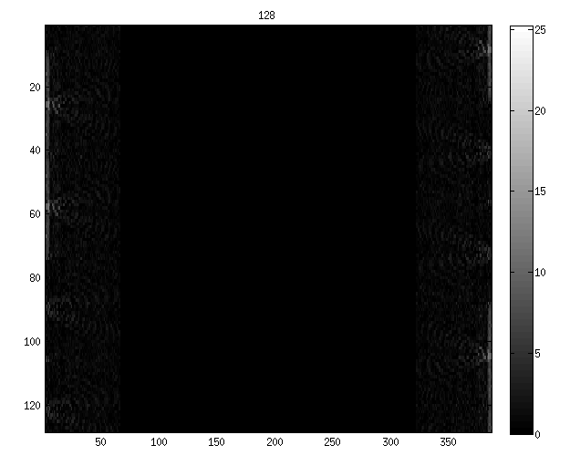
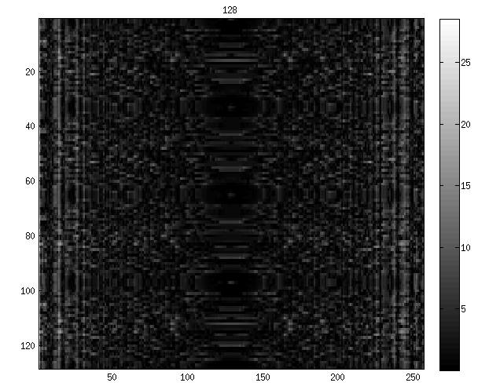
In 3D : Sinograms
Method supplement Method subtract
Error = | Sinogram theoretical – Sinogram supplement/subtract|

Slide 19
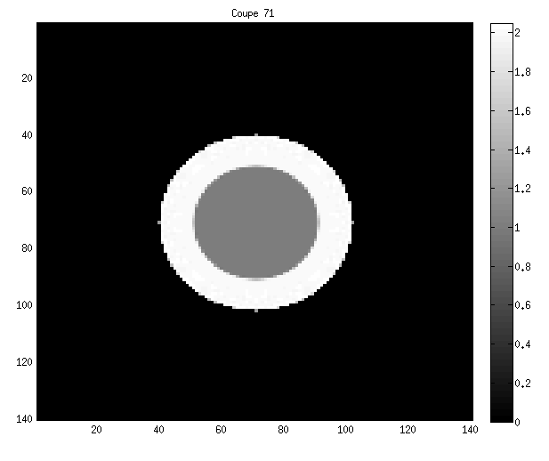
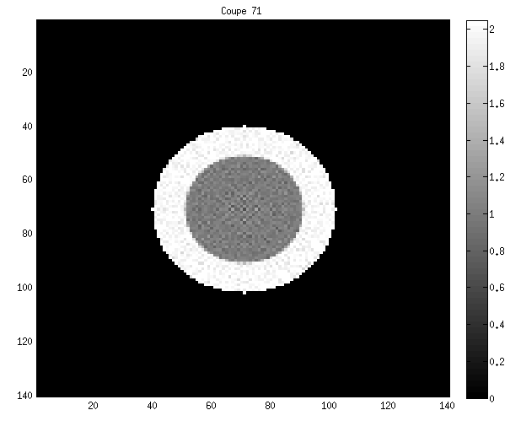
In 3D : Reconstruction using the subtract’s method
Theoretical Subtract

Slide 20
Thank you for your attention!
If you have any questions?

